Slide 1
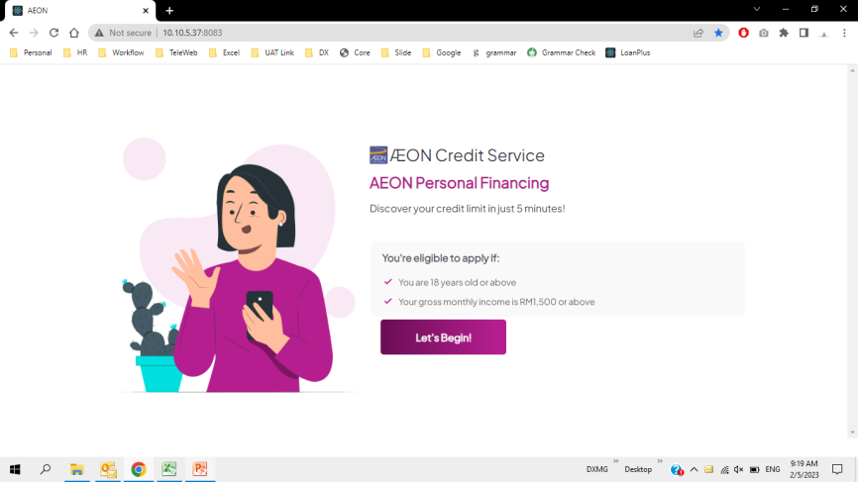
DX 49 | Recently Added | CreditLimitChecking | LoanPlus | Regression - New desktop UI | Normal Credit Limit Checking | Score D eKYC bypass | User able to received result as per score assigned. | 4 | Ain | 2/5/2023

Slide 2
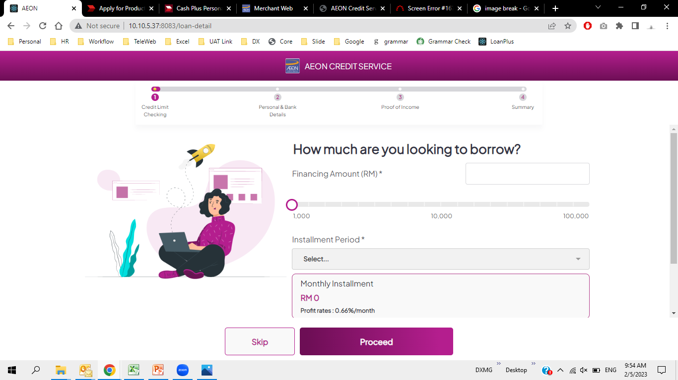
Why the action button right in the middle? Not as per proposed layout.
Image is still scrollable. Make it into one page view

Slide 3
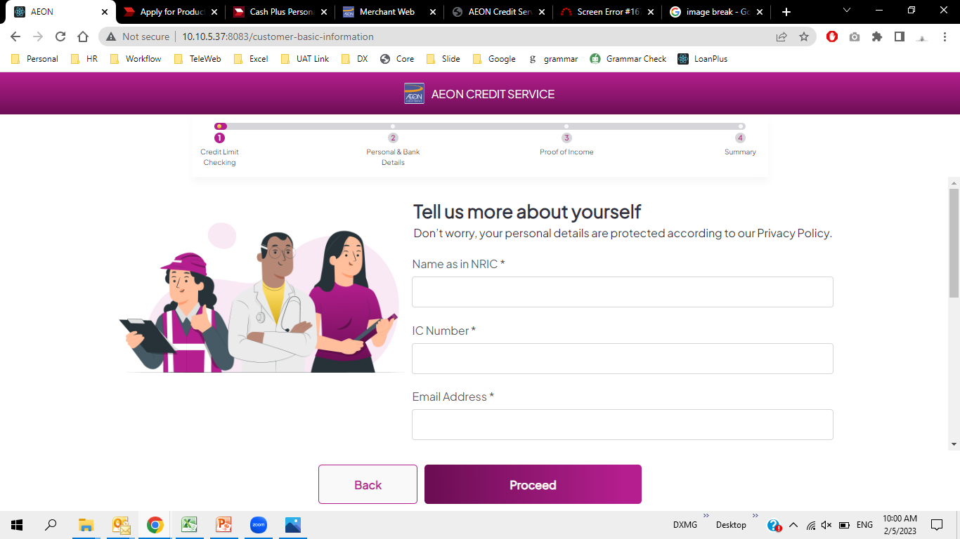
Why the action button right in the middle? Not as per proposed layout.
Image is still scrollable. Make it into one page view

Slide 4
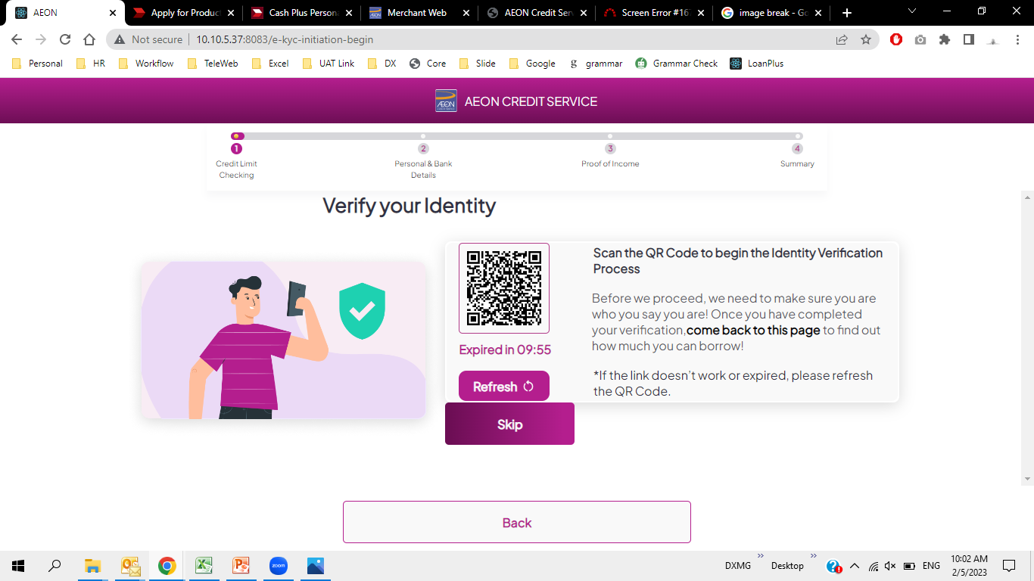

Slide 5
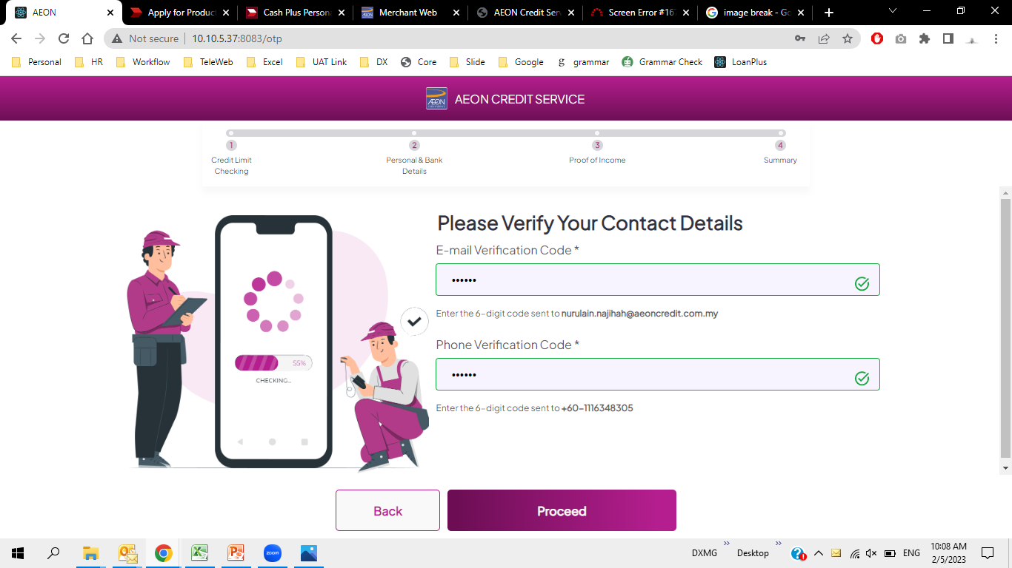

Slide 6
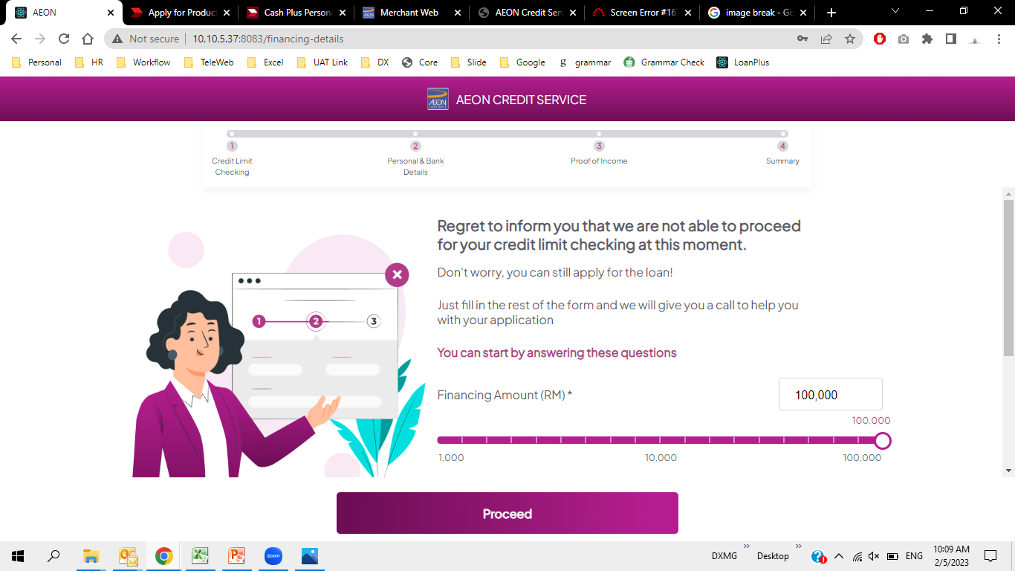
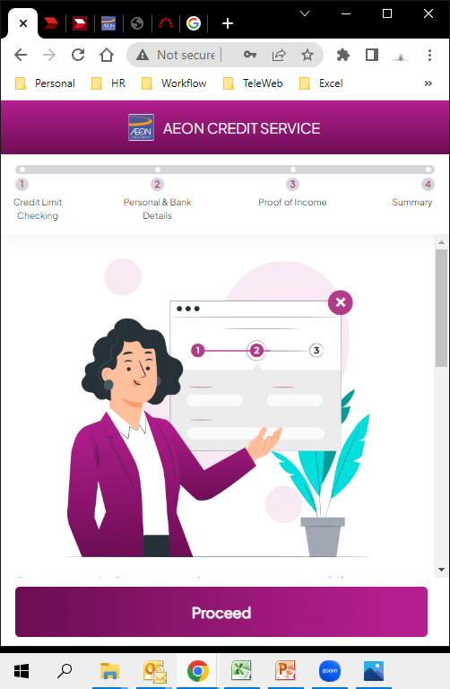
Why the action button right in the middle? Not as per proposed layout.
Page is still scrollable. Make it into one page view
Image too big and served no purpose. When page is squeezed, cust has to scroll for the result.

Slide 7
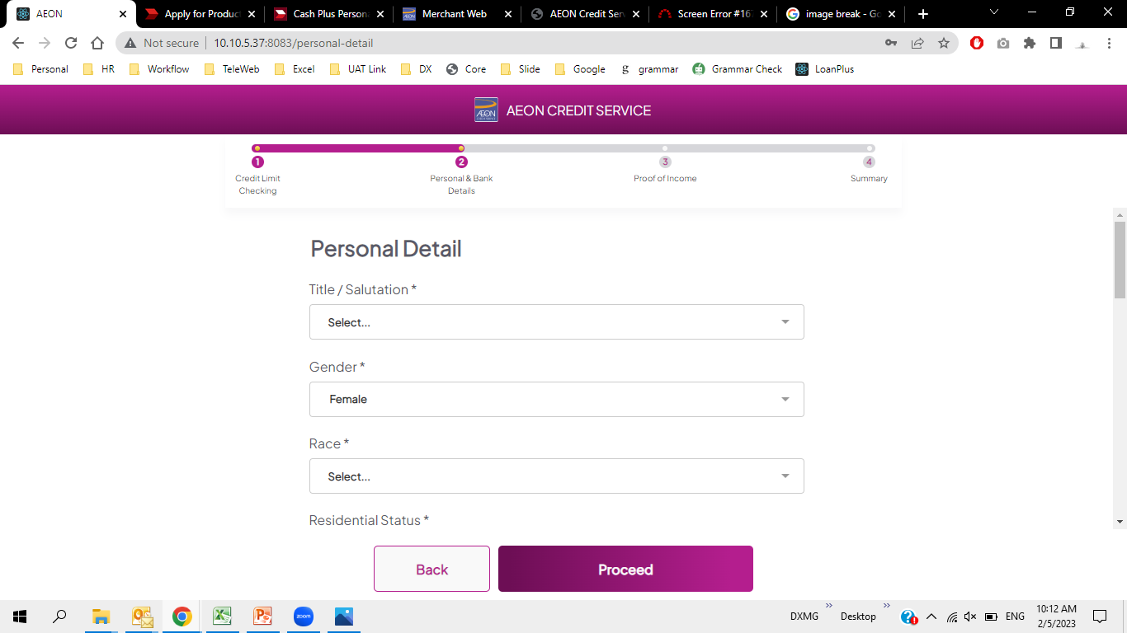
Why the action button right in the middle? Not as per proposed layout.
Page is not in two column as proposed.

Slide 8
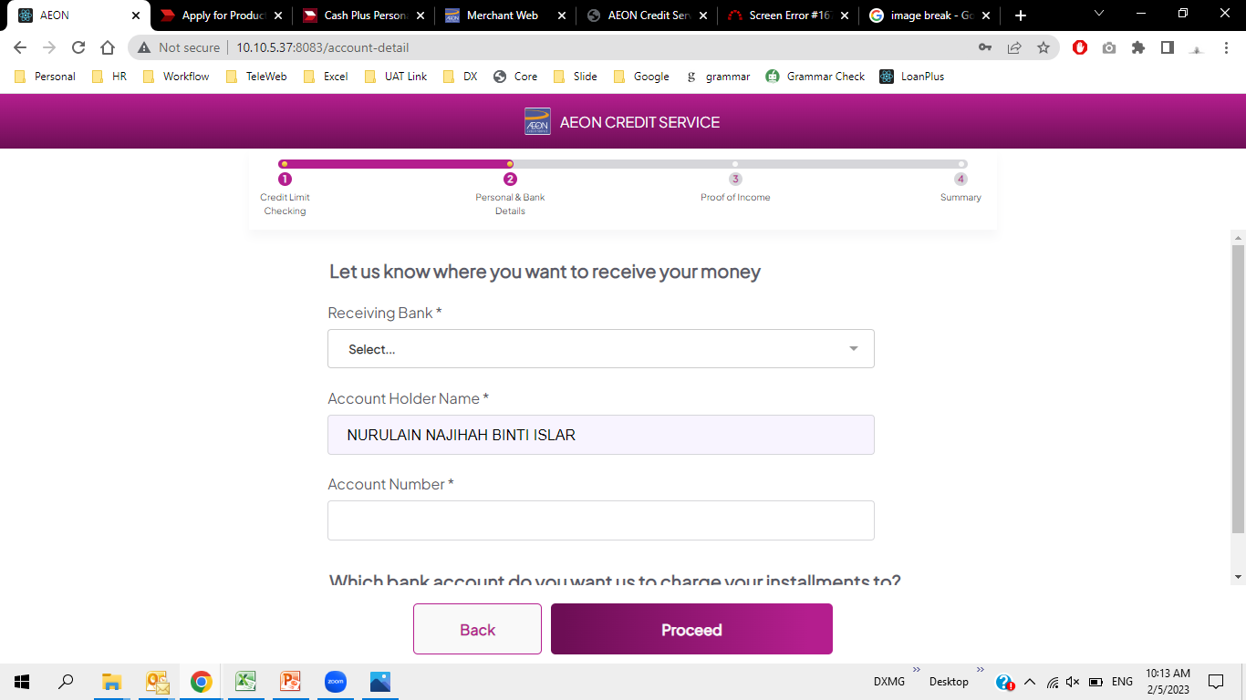
Why the action button right in the middle? Not as per proposed layout.
Page is not in two column as proposed.

Slide 9
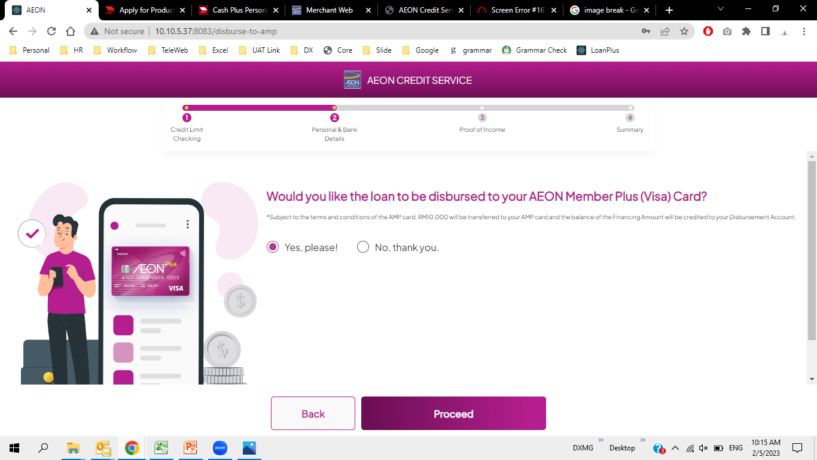
Word not wrapped. Too long and unreadable.
Why the action button right in the middle? Not as per proposed layout.
Page is too stretched on the margin

Slide 10
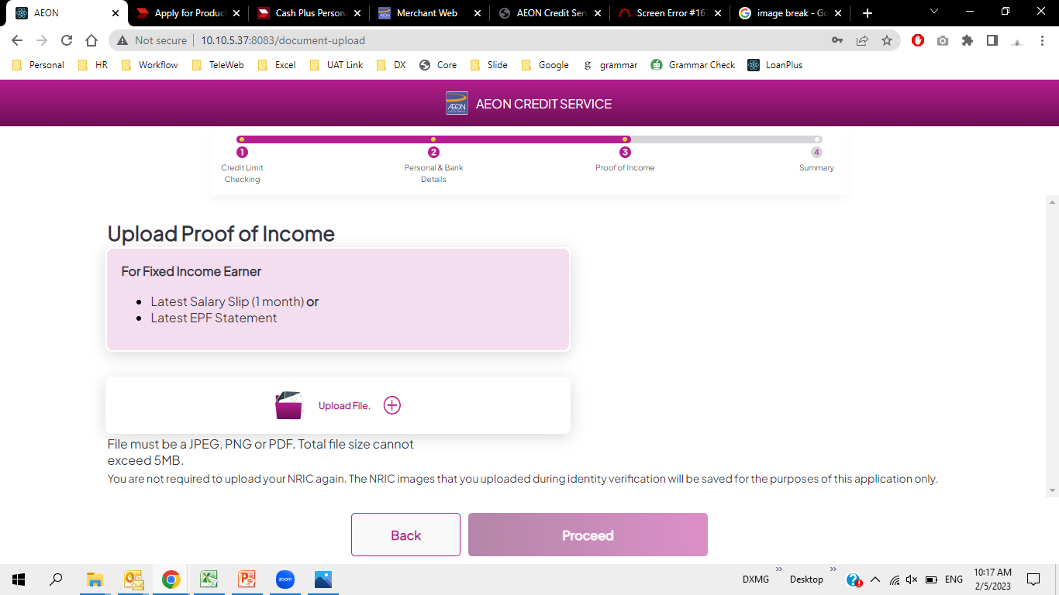
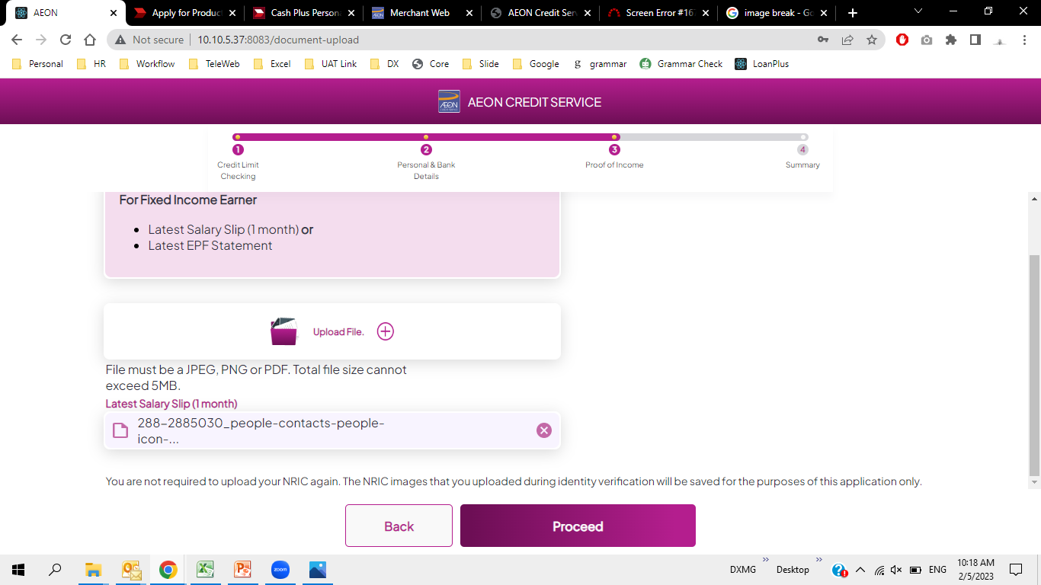
Why the action button right in the middle? Not as per proposed layout.
Uploaded file should show on the right column.

Slide 11
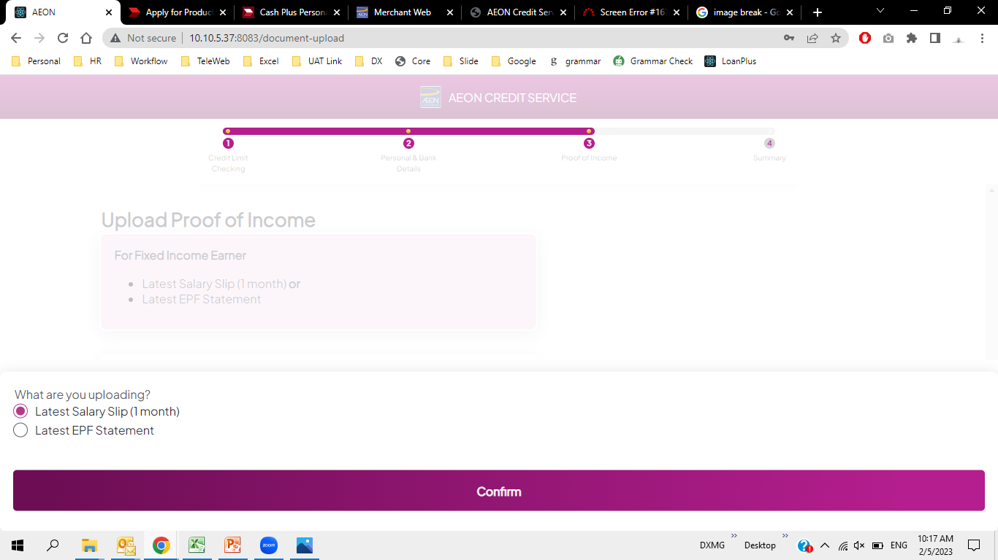
Instead of having it like this, proposed to have it like pop out and overlayed on the page.

Slide 12
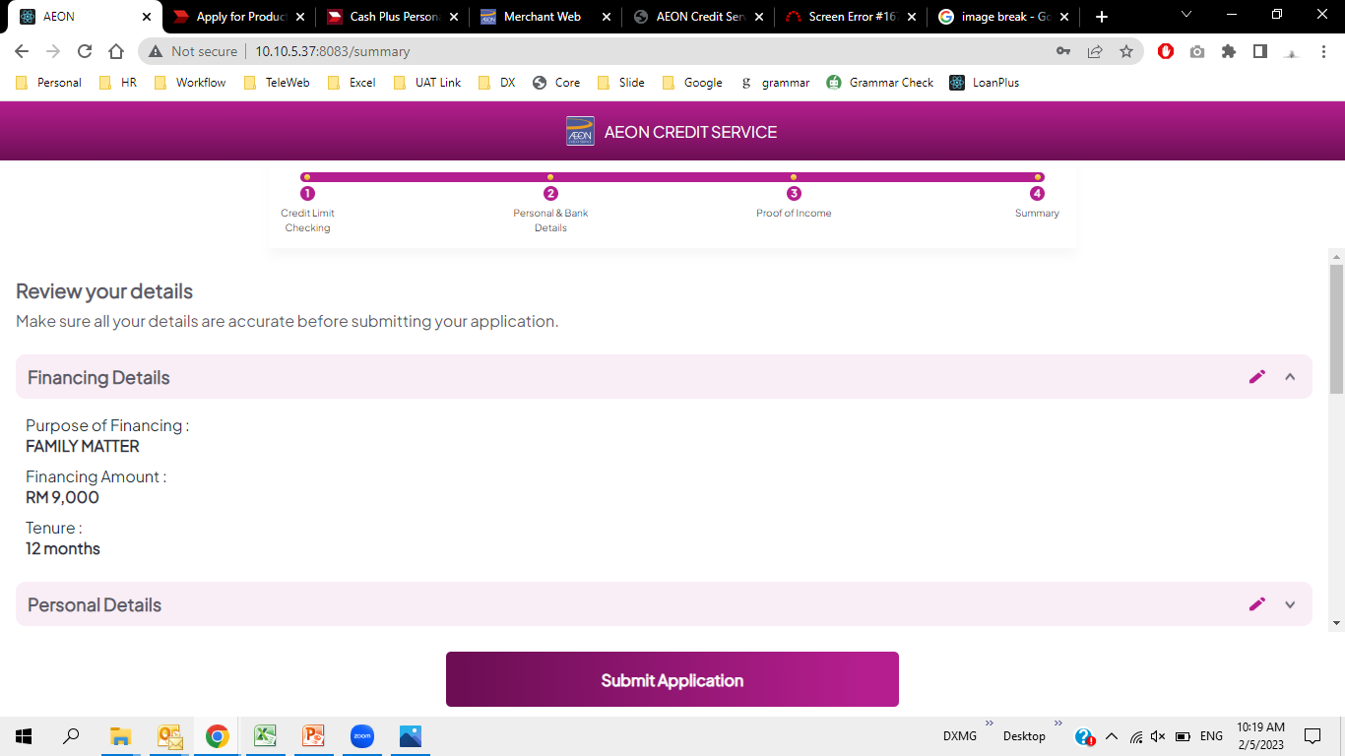
Why the action button right in the middle? Not as per proposed layout.
Page is too stretched to the side.
Should be two column as proposed layout.

